Slide 1
DevOps Traning
What is Docker
your text

Slide 2

Why we Need Docker

Slide 3
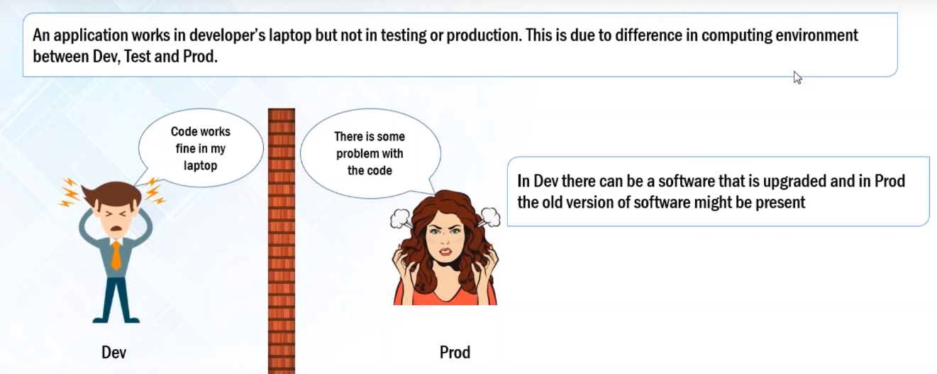
Problems Before Docker

Slide 4
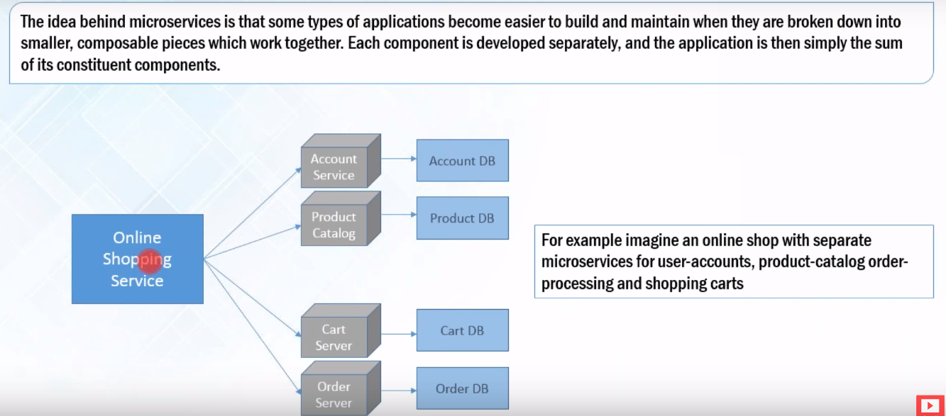
Problems Before Docker

Slide 5
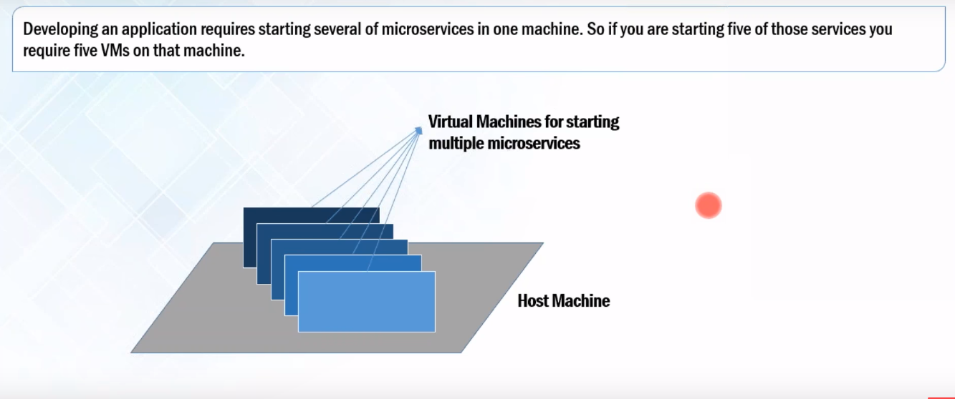
Problems Before Docker

Slide 6
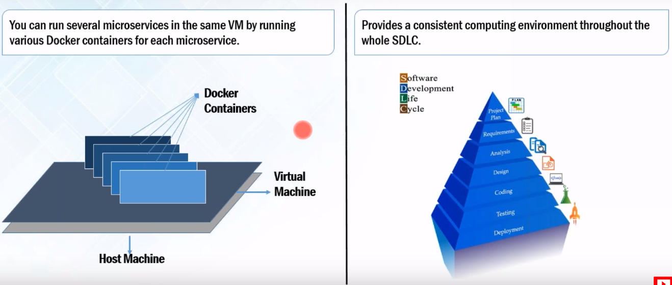
Docker Solves these Problems

Slide 7
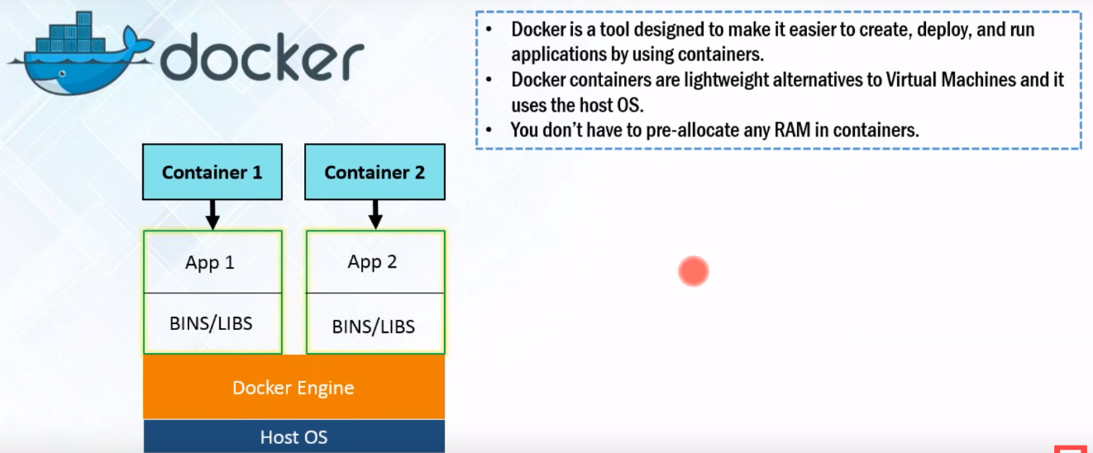
What is Docker

